Slide 1


Loan Default prediction using Machine Learning
BY: Priyanka Ashok Sujgure
x20136706

Slide 2
Content
Motivation
Methodology
Failed methods or ideas
Evaluation

Slide 3
Motivation
The financial crisis of 2008 was the worst economic catastrophe since the Great Depression of 1929.
Caused severe recession
High unemployment rate
One of the reason of the crisis:
Money given to borrowers without any background check by the banks

Slide 4
Goal, identify if a new client shows a high risk for loan default.
How can this help?
Reduce Uncertainty
Proportional Disbursement
Risk Reduction
03

Slide 5
Problem Statement
Can data mining and machine learning algorithms help to predict whether a loan borrower will repay or default?
Models used
Logistic Regression
Naïve Bayes
Random Forest
LightGBM
Xgboost

Slide 6
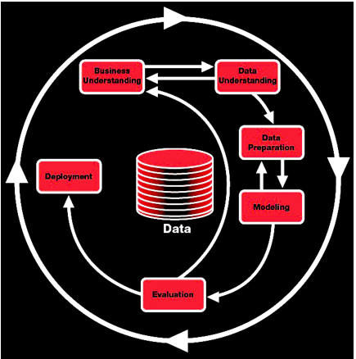
Methodology – CRISP-DM

Slide 7
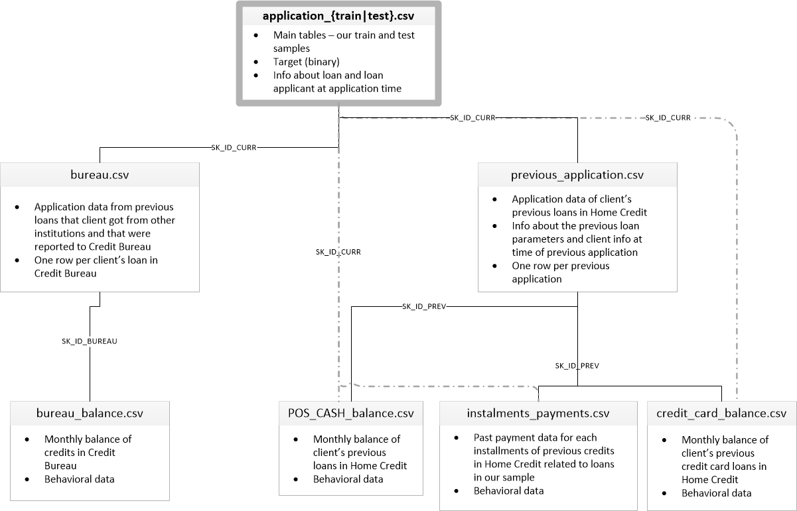
Data Understanding
1. Acquiring the data

Slide 8
Data Preparation
2. Exploratory Data Analysis:
Missing values
Finding out data abnormalities
Converting string categorical columns into numerical
Adding new columns to indicate the presence of categorical variables
Replacing illogical outliers with NAN
Imputing empty cells with median
Changing invalid entries into valid ones

Slide 9
Modeling
3. Predictive Modeling
ML Model :
PREDICTED OUTPUT
INPUT FEATURES/ COLUMNS
(After feature engineering)
(classification for 0 or 1)
Expected Target Outcome: 0 or 1, 0 – Not a defaulter, 1 – potential defaulter.
Perfomance Metrics used : F-score
Models currently used : Logistic regression, Random forest, XGBoost, LightGBM, Naïve bayes.

Slide 10
Modeling
4. Splitting the data in test and train to apply models and feature selection.
Randomly sampled 70% data
30% data
Training set
Testing set

Slide 11
Evaluation methods
As data is highly imbalanced confusion matrix is the best suitable.
In imbalanced data, accuracy is not reliable
If precision and recall cannot be distinguished, we opt for F-score.
F-score is the measure of evaluation in this project.

Slide 12
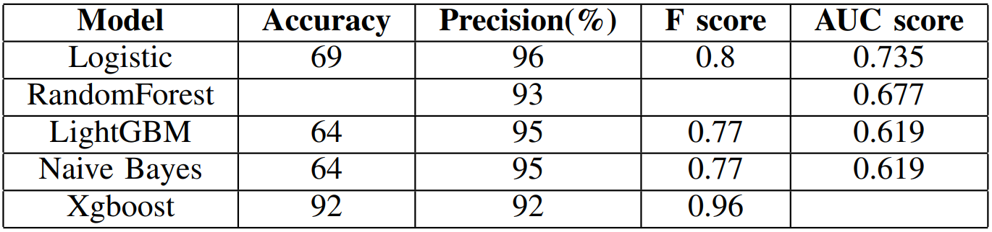
Evaluation (Confusion Matrix)
Xgboost outperforms compared to other models

Slide 13
Failed Models
Support Vector Machine – Took too long to predict.
Calculation of Rate of Interest – Data insufficient to perform calculation.

Slide 14

Thank you

